Slide 1


Chapter 2
Communication & Co-operation, Communication pyramid, Pareto principles, Communication & Image and Communication Barrier

Slide 2

Communication and Co-operation.
Ethical persuasion should respect the rights, goals and emotions of everyone concerned.
Creating co-operation should not involve the overriding of people’s needs and getting whatever you want at any cost.
WHY DON’T PEOPLE CO-OPERATE?
Indirect opposition
Justifiable opposition
Unjustified opposition

Slide 3
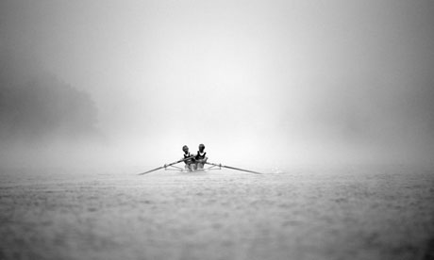
Fun Fact

Slide 4

Interpersonal Communication.
The first three have flows:
ineffective
stressful
counterproductive
1. Aggression
2. Passivity
3. Manipulativeness
4. Assertiveness
Example:
Would you....
This would mean....
I would feel....
What do you think?

Slide 5
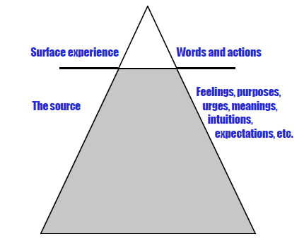
The Communication Pyramid.
A complex network of attitudes, beliefs, prejudices,
assumptions, ideas, associations, emotions and memories.
The Pareto principle can often apply to communication, as well as many other aspects of business, with up to 80% of a message being
contributed by the receiver of the message.

Slide 6
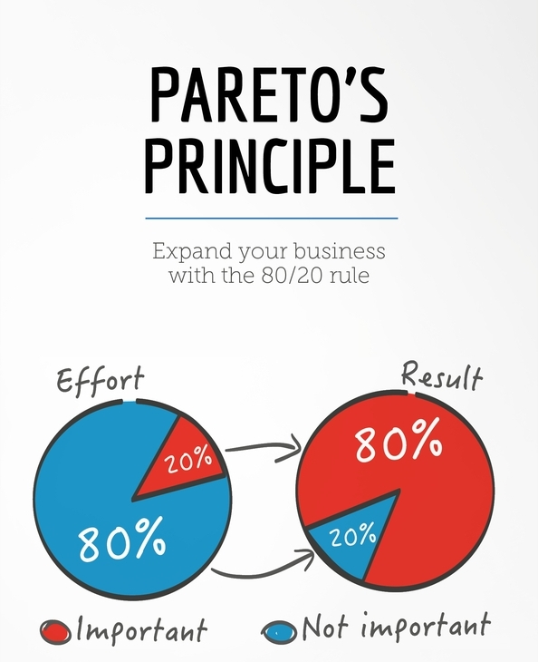
Activity
How can we use Pareto’s Principle in Communication?

Slide 7
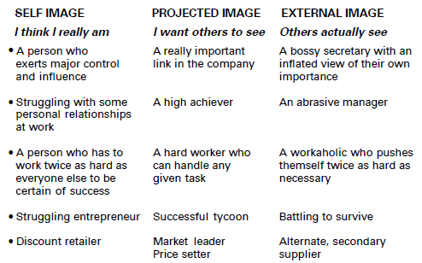
Communication and Image.

Slide 8
Purpose of Business Communication
Basic for effective leadership
Sharing ideas and information
Rational decision making
Performance of managerial functions
Developing company’s public image
Helping delegation of authority and responsibility
Explaining policies and programs
Basis of information

Slide 9
Barriers to effective communication
Sender Related Barriers
Receiver Related Barriers
Sender & Receiver Related Barriers
Situation related Barriers

Slide 10
Sender Related Barriers
Lack of communication goals
Absence of communication skills
Wrong choice of media
Abstracting: It may be understood as an act of focusing attention on some details and omitting others.
Absence of interpersonal sensitivity: In describing a situation unfavorable aspects are emphasized.
Inconsistent behavior: Insensitive individuals often use a language which is offensive to the receiver.
Differing frames of reference: Lack of shared experience may result in miscommunication.

Slide 11
Receiver Related Barriers
Negative attitudes and opinions: Wrong personal attitudes and opinions of receiver often act as barriers to effective communication.
Wrong inferences: Conclusions based on facts are called inferences.
Poor retention: An Average listener can retain only one-half of the message being heard.
Non-evaluation of the message due to distrust of the receiver: The receiver has a tendency to evaluate the sender and the message.

Slide 12
Receiver Related Barriers
Selective and poor listening: Selective listening refers to the people’s tendency to hear only what they want.
Perceptions: Stereotyping refers to the tendency to categories people into a single class on the basis of some trait. Projection is a perceptual process by which we try to attribute our own thoughts and feelings to others.
Lack of responsive feedback: An inappropriate response hurts the sender’s ego or feelings.

Slide 13
Sender & Receiver Related Barriers
Status consciousness: If the sender is excited, nervous and perplexed, he will not be in a position to organize his message properly.
Emotions: Emotions, be it either from the side of the sender or the receiver, may create a barrier.
Interpretation of words: A single word that is used by the sender with an intended meaning may convey different meaning to the receiver.

Slide 14
Situation related Barriers
Noise
Communication climate
Distance
Mechanical Failure
Time pressure
Information overload: The receiver cannot accommodate a heavy load of message from the sender.
Jargon: Each ``profession has its special vocabulary. When it is used outside the group, it becomes unintelligible.

Slide 15
Ways to Improve Communication Effectiveness
Communication training
Enhancing language knowledge
Providing communication equipment's
Appropriate organizational structure
Use of informal communication
Developing interpersonal trust
Listening
Effective feedback
Nondirective counseling
Nonverbal communication
Motivation

Slide 16


